Slide 1
DAE Risk Management Webpage https://ww.icumed.com/risk_management
Presenter: Jerry Xiao
26-April-2021

Slide 2
Goals:
  Develop a platform based on RdPDM™ Machine Learning Technology to provide solutions for ICU Medical needs in the fields of:
  Risk analysis (e.g., DFMEA, PFMEA, UFMEA, Hazard Analysis)
  Complaint data risk analysis (e.g., FDA Maude)
  Root cause analysis
  Periodic risk file review
  Remediation on the legacy risk files (QSR Harmonization plan)
  Risk knowledge training
  Provide supports for Audits
  Others

Slide 3
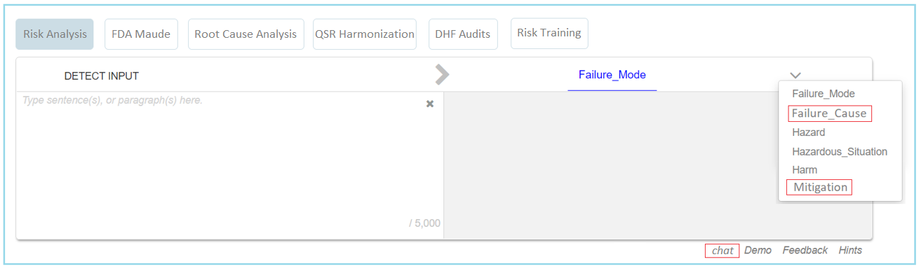
Webpage Layout https://ww.icumed.com/risk_management

Slide 4
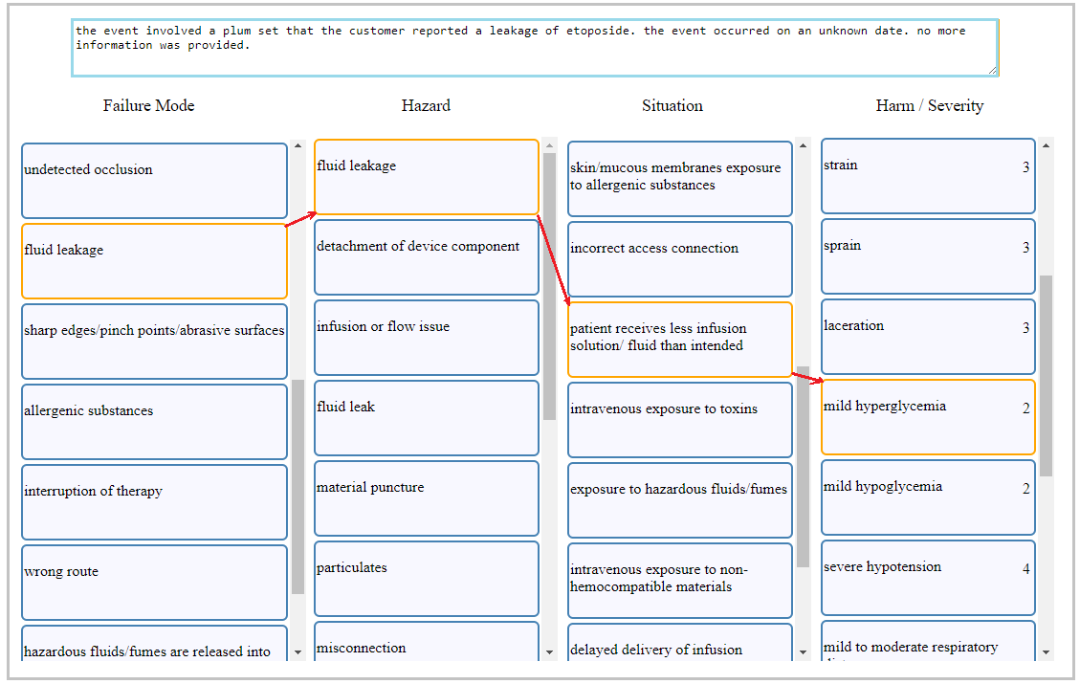
Section 1 Risk Analysis
Use scenario: when working on FMEA worksheet, DAE shall develop failure modes, failure causes, hazards, hazardous situations, harms, severity level, mitigation actions manually.
Webpage operation: user copies the input sentence and picks up the best of predicting options through entire which are provided by ML

Slide 5
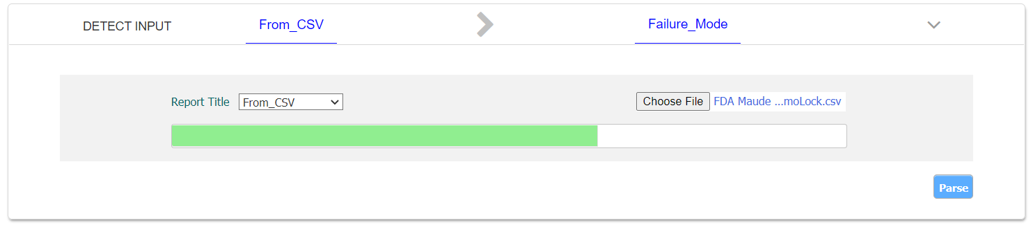
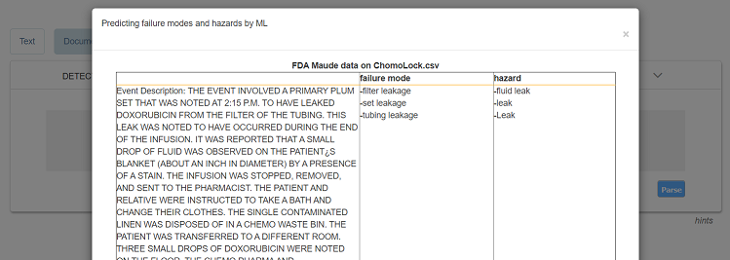
Section 2 FDA Maude Data Analysis
Use scenario: when working on periodic risk file review, DAE needs to download complaints from Maude on specific product during the periods, then determine failure modes on each complaint based on ‘event text’ and ‘device problem’.
Webpage operation: user uploads the complaint raw data at webpage and obtain failure modes and hazards automatically.

Slide 6
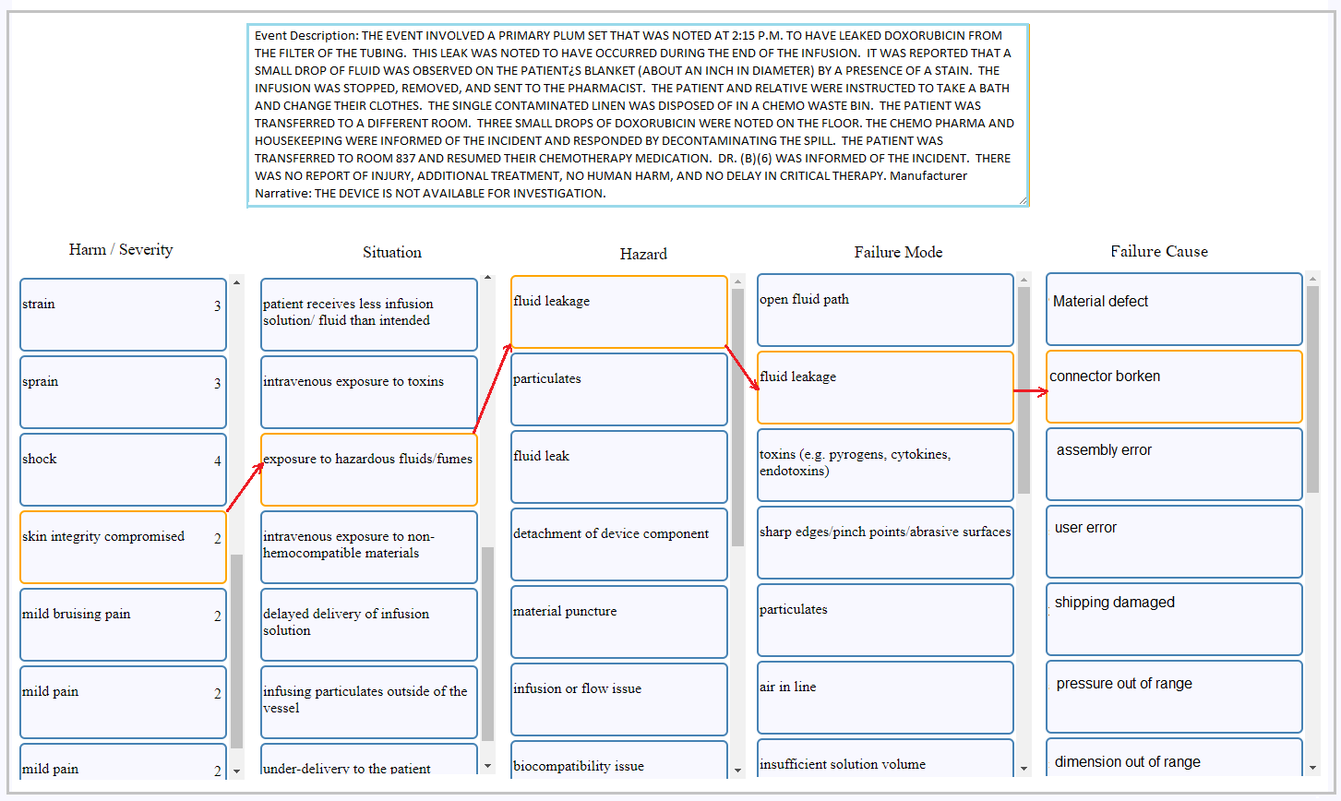
Section 3 Root Cause Analysis
Use scenario: when working on complaint data, DAE needs to trace back fail cause along the path harm → hazardous situation → hazard → failure mode → failure causes.
Webpage operation: user copies the complaint statement and picks up the best of predicting options through entire which are provided by ML

Slide 7
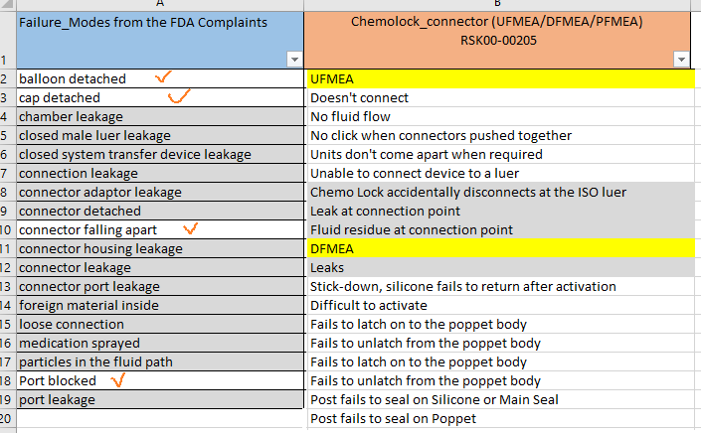
Section 4 Periodic Risk File Review
Use scenario: users need to update risk files periodically for addressing new failure modes, hazards, or P1 increasing from complaint data in a period of times per ISO 14971.
Webpage operation: users may upload complaint data (e.g. FDA Maude) and target risk files (e.g. FMEA); the webpage shall provide lists of new failure modes and lists of increased P1 value

Slide 8
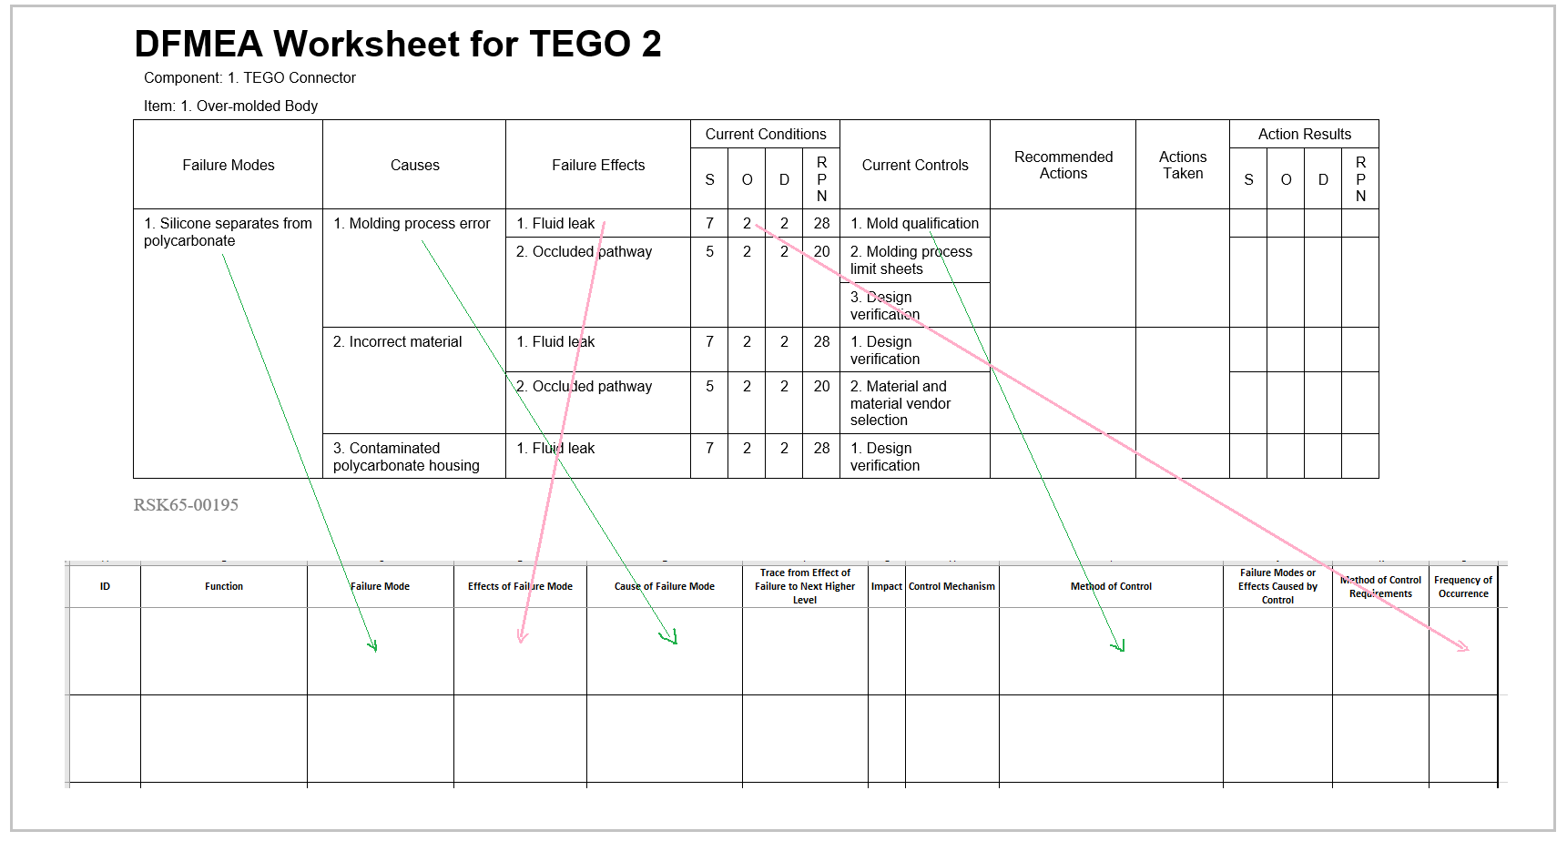
Section 5 Remediation on Legacy Risk Files
Use scenario: users need to convert legacy risk files into new templates due to requirements from ISO 14971 new version, Eu MDR, audit remediation actions, or company QMS integration.
Webpage operation: users need to upload the legacy risk files to webpage and all history data will be dumped into new template efficiently and accurately. Furthermore, more data can be filled as needs (e.g. ID, S, RR)

Slide 9
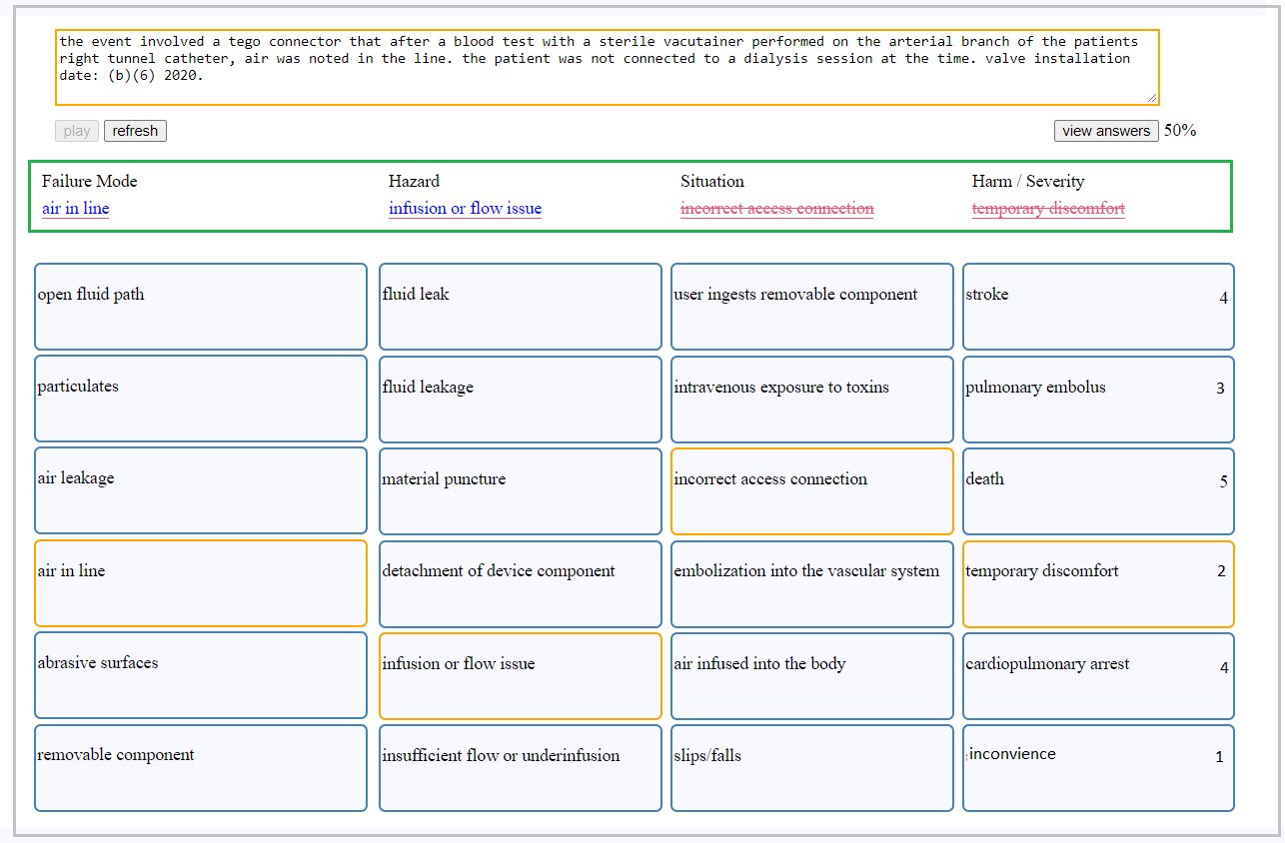
Section 6 Risk Knowledge Training
Use scenario: entry level engineers shall have training to familiar with how to define failure modes, failure causes, hazards, hazardous situations, harms, severity level, mitigation levels per job requirements.
Webpage operation: the system provides random training material, scores the results, and indicates the correction visually.

Slide 10
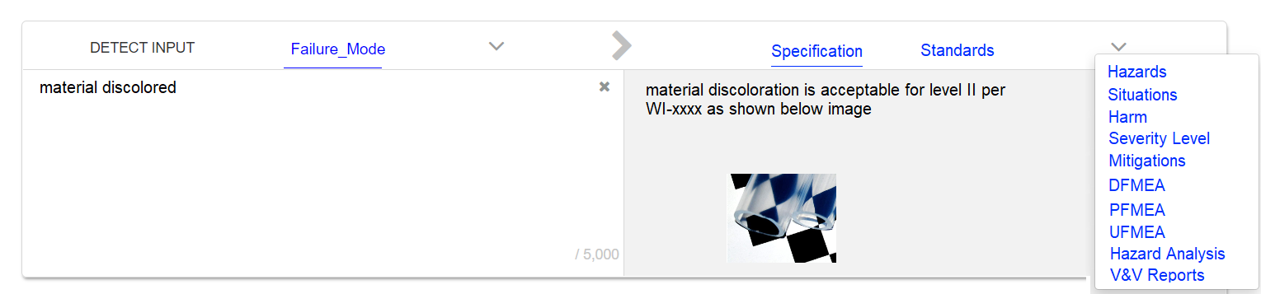
Section 7 Support Risk Management Audit
Use scenario: auditor wants to quickly know how the failure mode ‘material discolored’ is managed (Sam’s question).
Webpage operation: the system shall direct to associated engineering specifications, hazards, hazardous situations, harms, severity levels, mitigation actions, risk files (DFMEA, PFMEA, UFMEA, Hazard analysis), test reports, etc.

Slide 11

Section 8: Others

